Slide 1
CAD Project
Developing a File Explorer with a GUI using Python

Slide 2
ProjectX

Slide 3
What is a File Explorer
Why the need of a File Explorer
File Explorer is a GUI program or a software that enables users to access, edit and manage data, files and other content stored on a computer.
So a person can carry out the following functions:
Browse files and folders in his/her computer
Open files in a suitable application
Perform operations like cut, copy, rename, paste, delete, rename etc.

Slide 4
Languages used to build ProjectX
Platforms used to build ProjectX
Python 3
GTK 3+ (Gimp Tool Kit) for developing the User Interface
Elementary OS (Linux)
Python IDLE
Sublime Text

Slide 5
How CAD is integrated in this project?
CAD used in designing layout of the explorer
Icons are aesthetically designed with drop shadows
Placement of icons plays a pivotal role in user experience

Slide 6
What has been implemented

Slide 7
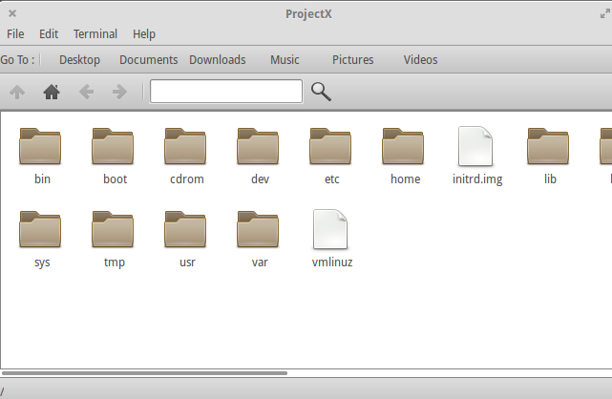
Displaying All files and folders

Slide 8
Current Directory infobar

Slide 9
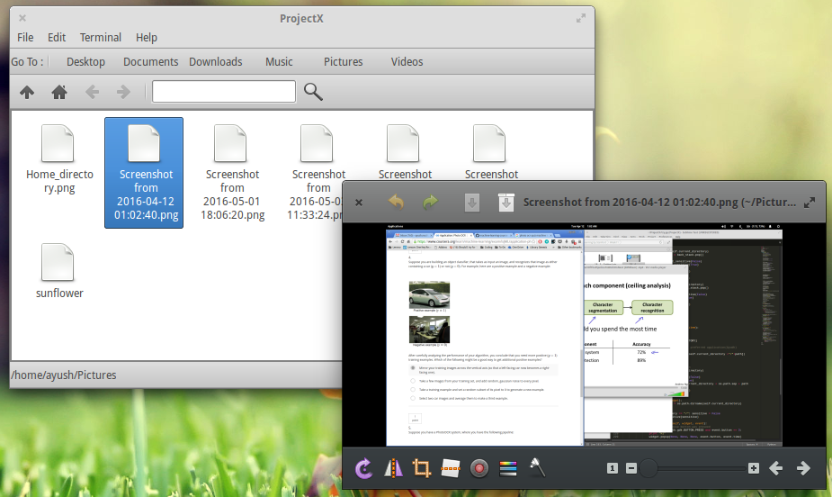
Opening any file with its default assigned application/Software

Slide 10
Menubar

Slide 11
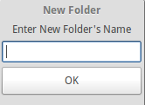
Menubar (New Folder)

Slide 12
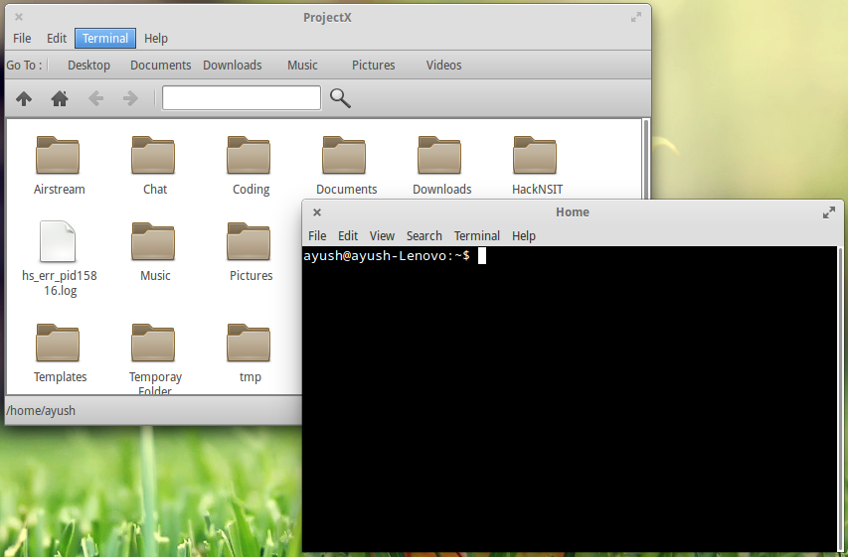
Menubar (Launch Terminal)

Slide 13
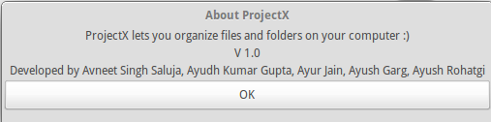
Menubar (About ProjectX)

Slide 14
Bookmarks Bar

Slide 15
Toolbar

Slide 16

Toolbar (Search Bar)

Slide 17
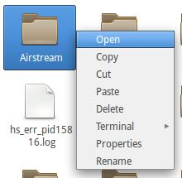
Right click menu after selecting a file

Slide 18
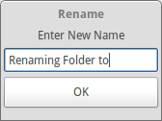
Right click menu after selecting a file (Rename)

Slide 19
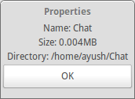
Right click menu after selecting a file (Properties)

Slide 20

Thanks!
Avneet Singh Saluja
247/COE/13
Ayudh Kumar Gupta
248/COE/13
Ayur Jain
249/COE/13
Ayush Garg
250/COE/13
Ayush Rohatgi
251/COE/13

